Slide 1
Chapter One
Overview of the Internet and WWW

Slide 2
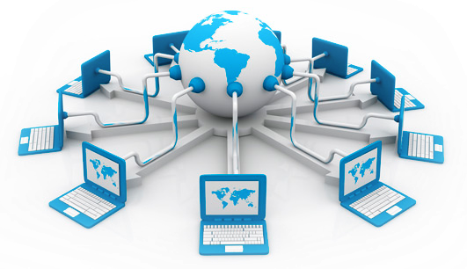
What is Internet?
The Internet (or internet) is the global system of interconnected computer networks that uses the Internet protocol suite (TCP/IP) to communicate between networks and devices.
It is a network of networks that consists of private, public, academic, business, and government networks of local to global scope, linked by a broad array of electronic, wireless, and optical networking technologies.
The Internet carries a vast range of information resources and services, such as the inter-linked hypertext documents and applications of the World Wide Web (WWW), electronic mail, telephony, and file sharing.

Slide 3
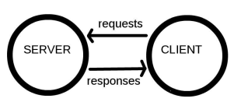
… cont'd
The Internet is a technical infrastructure which allows billions of computers to be connected all together.
Computers connected to the web are called clients and servers. A simplified diagram of how they interact might look like this:
Clients:
  are the typical web user's internet-connected devices (for example, your computer connected to your Wi-Fi, or your phone connected to your mobile network) and web-accessing software available on those devices (usually a web browser like Firefox or Chrome).
Servers
  are computers that store webpages, sites, or apps. When a client device wants to access a webpage, a copy of the webpage is downloaded from the server onto the client machine to be displayed in the user's web browser.

Slide 4
Terminologies
World Wide Web:
  a collection of data stored and shared in the digital space.
Browser:
  A piece of software such as Mozilla Firefox and Internet Explorer that allows a computer to access and display documents, view pictures, hear sound, and view video clips from the World Wide Web.
Webpage:
  is a document, commonly written in HTML, that is viewed in an Internet browser.
Website:
  A website (also written as web site) is a collection of web pages and related content that is identified by a common domain name and published on at least one web server. The first page of a website is called home page.
  Static websites:
    ones that are fixed and display the same content for every user, usually written exclusively in HTML.
  Dynamic websites:
    one that can display different content and provide user interaction, by making use of advanced programming and databases in addition to HTML

Slide 5
...cont'd
Hypertext Transfer Protocol (HTTP):
  It is the set of rules by which Web pages are transferred across the Internet.
Hypertext:
  A text which contains links to other texts.
  Hypertext documents are interconnected by hyperlinks, which are typically activated by a mouse click, keypress set, or screen touch.
Hyperlink:
  Text, images, graphics that, when clicked with a mouse (or activated by keystrokes) will connect the user to a new Web site. The link is usually obvious, such as underlined text or a "button" of some type, but not always.
HTML:
  Is standard Markup Language for documents designed to be displayed in a web-browser.
  is the most basic building block of the Web.
  Other technologies besides HTML are generally used to describe a web page's appearance/presentation (CSS) or functionality/behavior (JavaScript).
  Markup Language is a computer language that uses tags to define elements within a document.

Slide 6
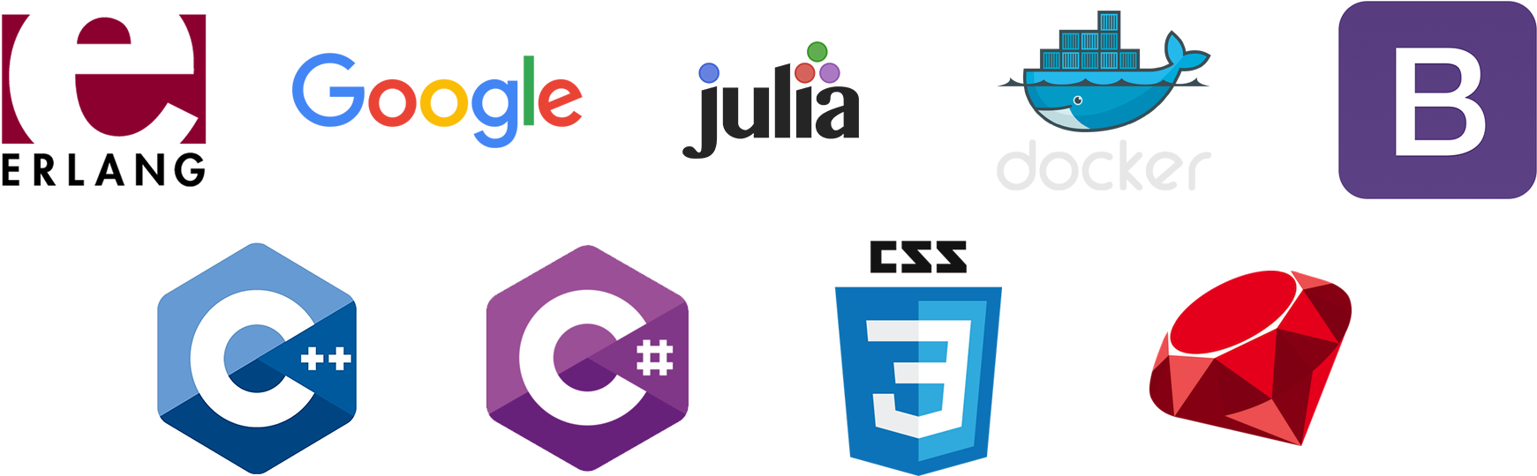
Computer Programming Language
Computer programming languages allow us to give instructions to a computer in a language the computer understands.
any of various languages for expressing a set of detailed instructions for a digital computer.
A programming language is a computer language programmers use to develop software programs, scripts, or other sets of instructions for computers to execute.

Slide 7
Programming and Web development
Web development is coding or programming, which enables website functionality based on client requirements and deals with building websites’ non-design aspect.
Web development can be used for complex web-based applications, social network applications and electronic business applications based on the requirement.
Web development is as follows:
  Client-side coding
  Server-side coding
  Database technology
Front-end development is of constructing what a user sees when they load a web application.
Back-end development mainly controls on the backend of a web application. A back-end often uses a database to generate the front-end.

Slide 8
Scripting Vs Programming Language
Programming Languages | Scripting Languages
A programming language is a formal language that specifies a set of instructions that can be used to produce various kinds of output. It Consists of instructions for a computer. | A programming language for a runtime system that automates the execution of tasks that would otherwise be performed individually by a human operator.
compiler- based language | Interpreter based Language
compressed into smaller packages that do not need to be interpreted by another language or application. | written in one language and interpreted within another program. For instance, JavaScript has to be incorporated within HTML, which the Internet browser will then interpret.
Hosting is not required | Require hosting
e.g. C, C++, C#, Java, VC++, VB, BASIC, Pascal... | e.g. JavaScript, VB script, PHP, Python, Lua. … etc.

Slide 9
The End!

